Slide 1

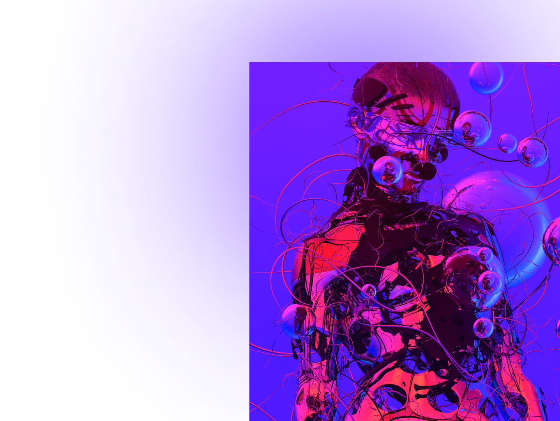




We put the power of blockchain to work for your next
marketing campaign, promotion, or rewards program.

Slide 2
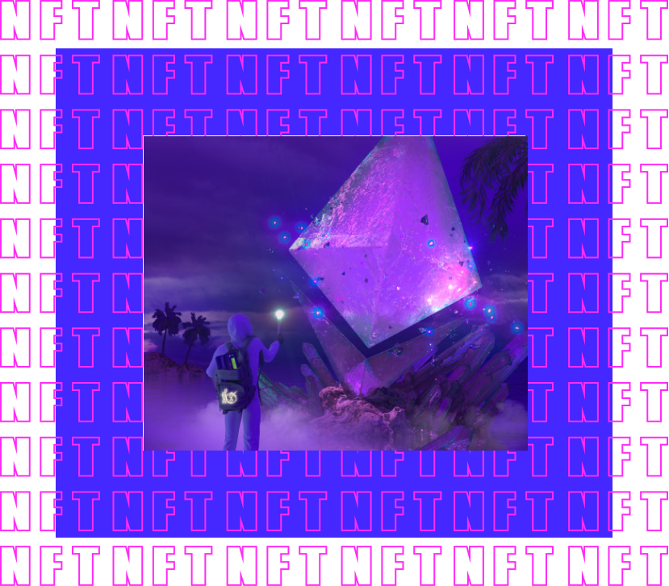

A non-fungible token, also a unique token, is a type of cryptographic token, each instance of which is unique and cannot be exchanged or replaced with another token

Slide 3
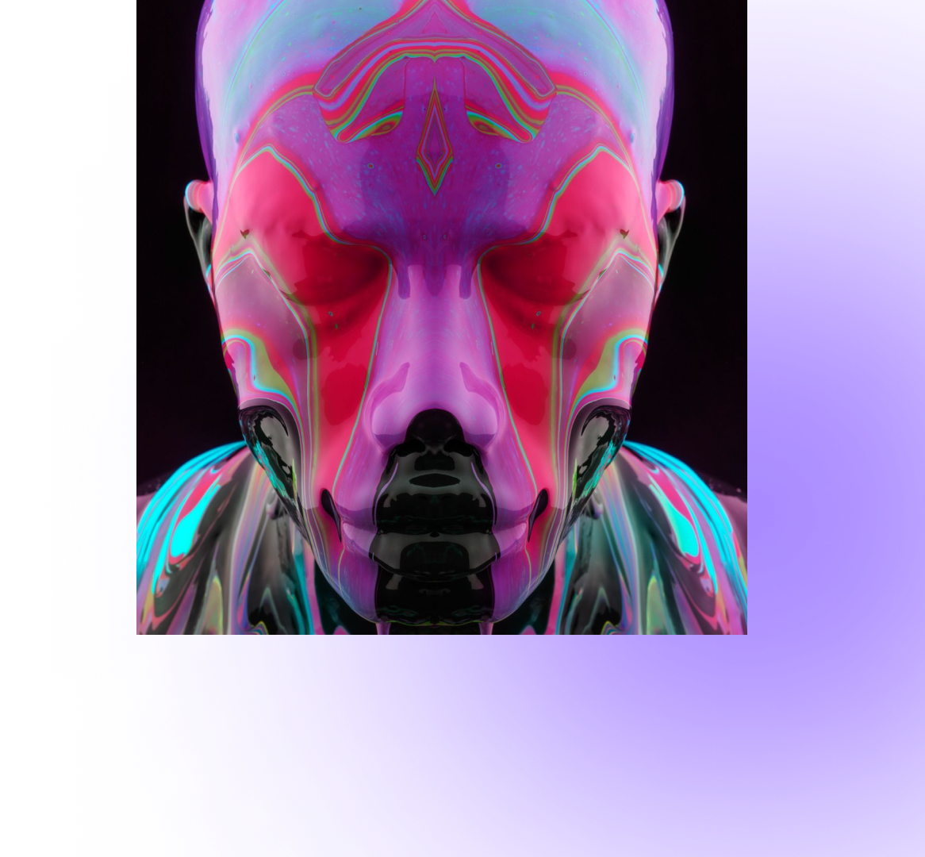

NFT market skyrocketed in the first half of 2021, topping $40bn
The market cap jumped more than 10x and more mainstream applications of NFTs, notably NBA Top Shot, have also broken into popular culture, capturing more than 800,000 users and growing its monthly sales from $44M to $232M in Q1 of 2021 alone.

Slide 4




Slide 5
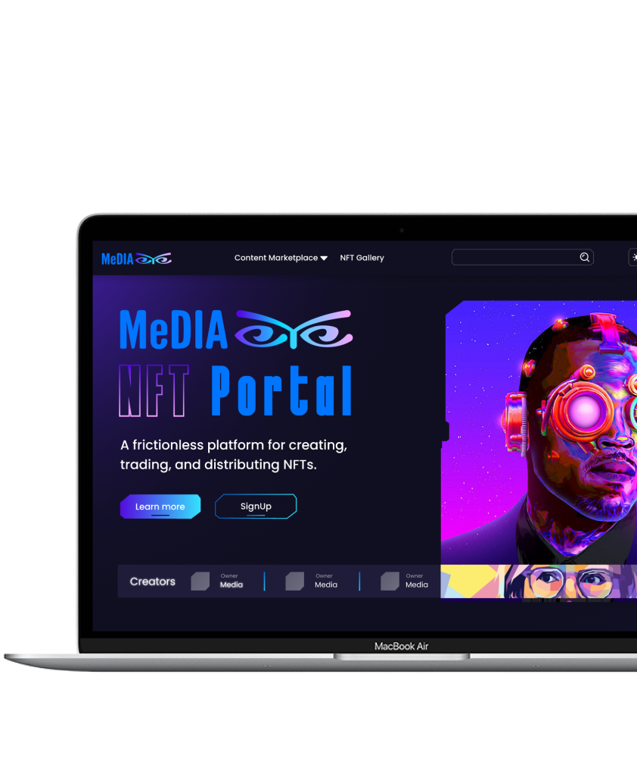
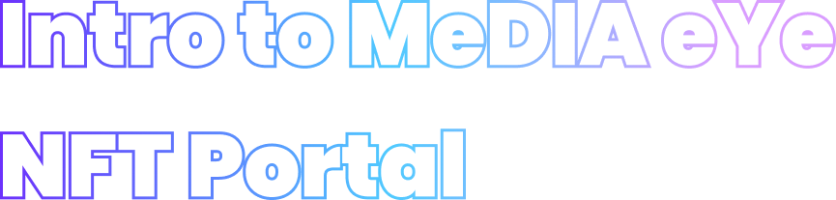
MeDIA eYe is a cross chain non-custodial NFT platform developed by technology enthusiasts and entrepreneurs to reduce the complexities around creating NFT media campaigns for brands, artists, gamers, entertainers, social media, crypto protocols, collectors and others, interested in increasing brand awareness, reach, engagement, immutably store value or transfer digital assets, efficiently.
Other use cases of the MeDIA eYe platform include digital assets and rewards for gamers, sports fans, esports and bespoke NFTs to commemorate events or alternative forms of direct-digital experiences.
MeDIA NFT Portal puts the power of blockchain to work for your next marketing campaign, promotion, rewards program or creating a collectible.​

Slide 6



MeDIA eYe is looking into the future of NFTs’ immense influence within the Metaverse, a collective virtual shared space, created by the convergence of virtually enhanced physical reality. MeDIA eYe NFT Platform is designed to help integrate the physical into the virtual reality existing on the blockchain.

Slide 7
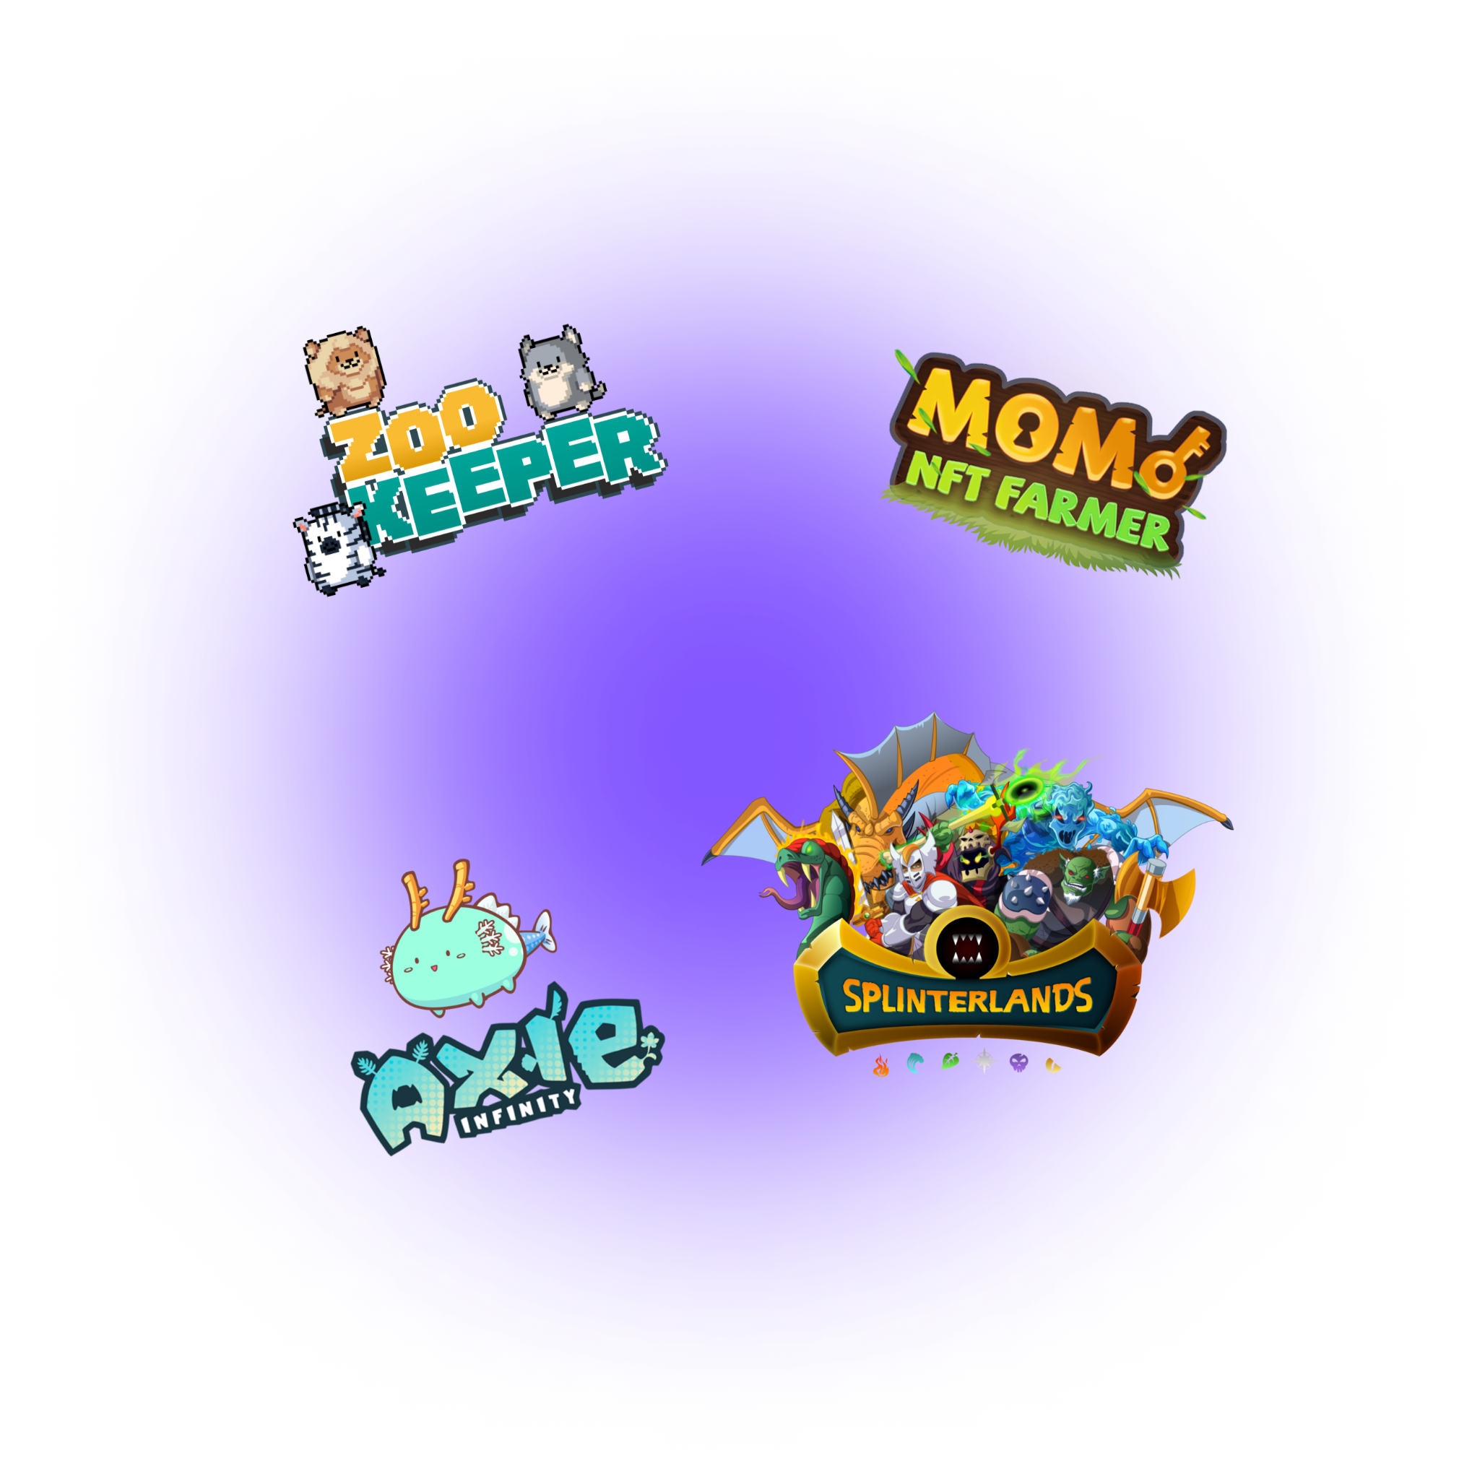

The digital nature of NFTs has resulted in some exciting new developments. Gaming mixed with DeFi is delivering amazing traction for gaming and digital experiences, NFTs stand at the forefront of these exciting new markets.

Slide 8


...to unlock the limitless potential of NFTs for brands and digitized content markets everywhere.

Slide 9

...we cater to diverse range of brands & customized content
The platform is designed to support marketers, artists, businesses, collectors, gamers, entertainment, and sports organizations wanting to merchandise, promote and advertise their services and products.

Slide 10
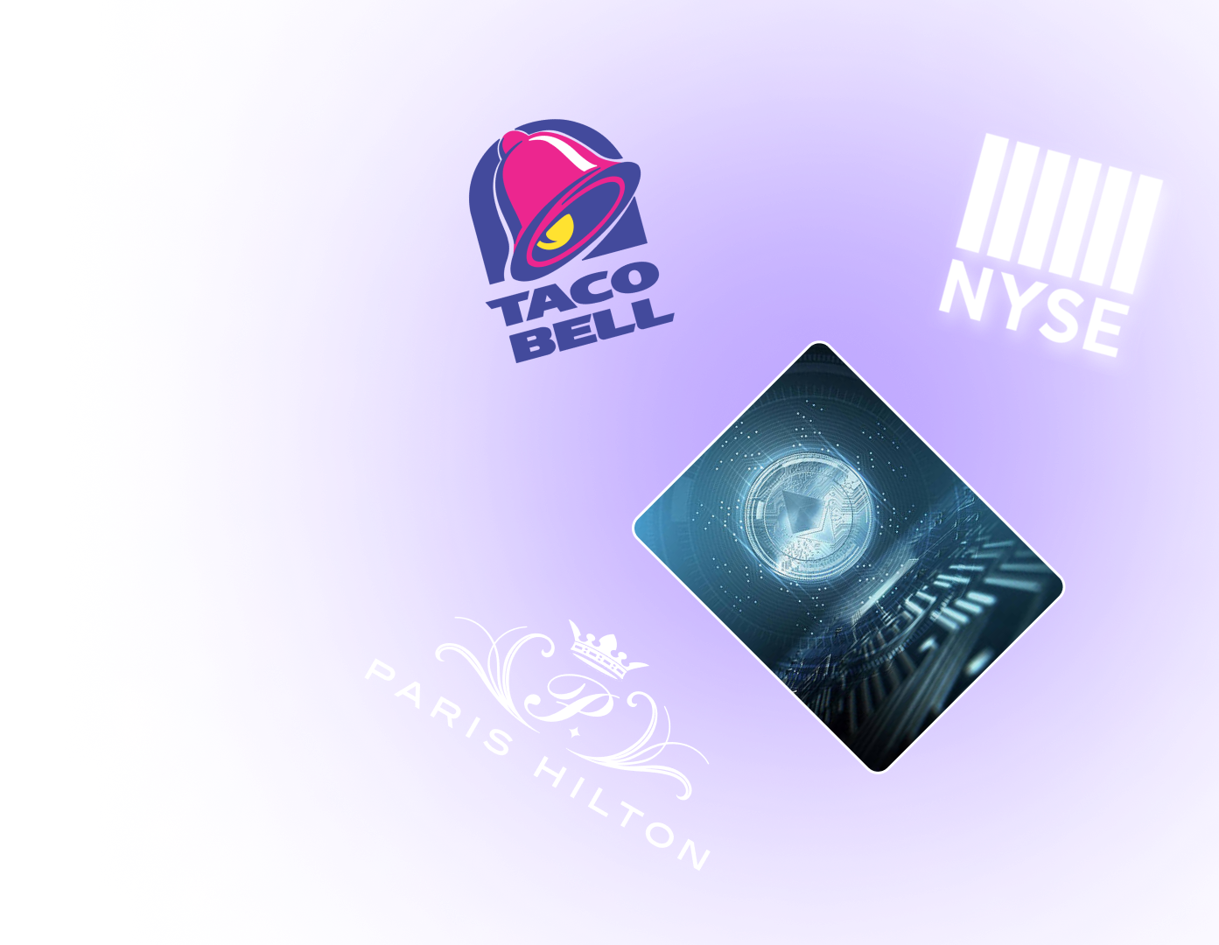

Brands that are looking to increase awareness of their products are already seeing the benefits of using NFTs to create unique consumer experiences.

Slide 11
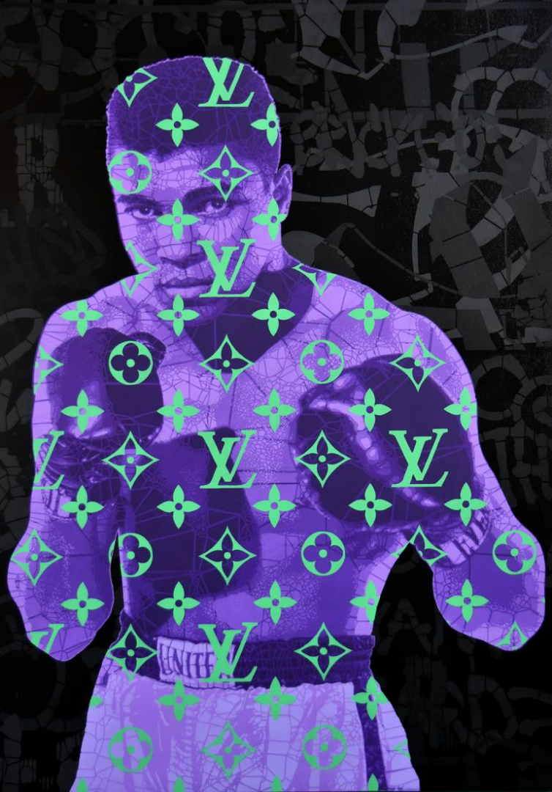


Brands need to adapt and upgrade to the new digital reality and digital overlay.
Brands using NFTs can thrive in a novel digital economy.

Slide 12

We are focused on helping create brand awareness
While there are many platforms for creating NFTs, MeDIA eYe caters to creators that are focused on creating brand awareness.

Slide 13

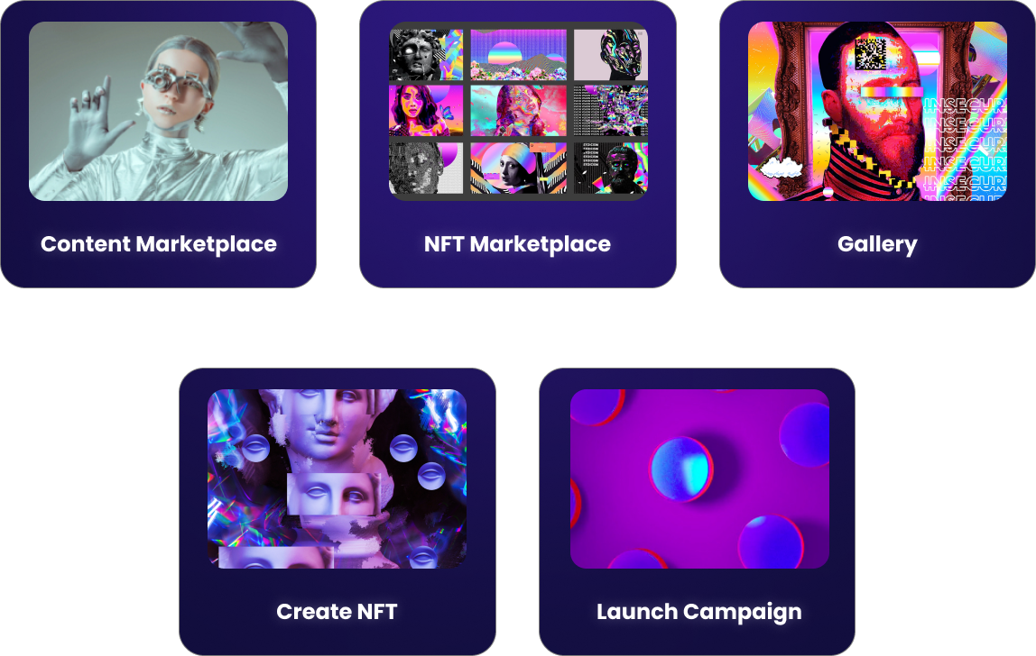

Slide 14

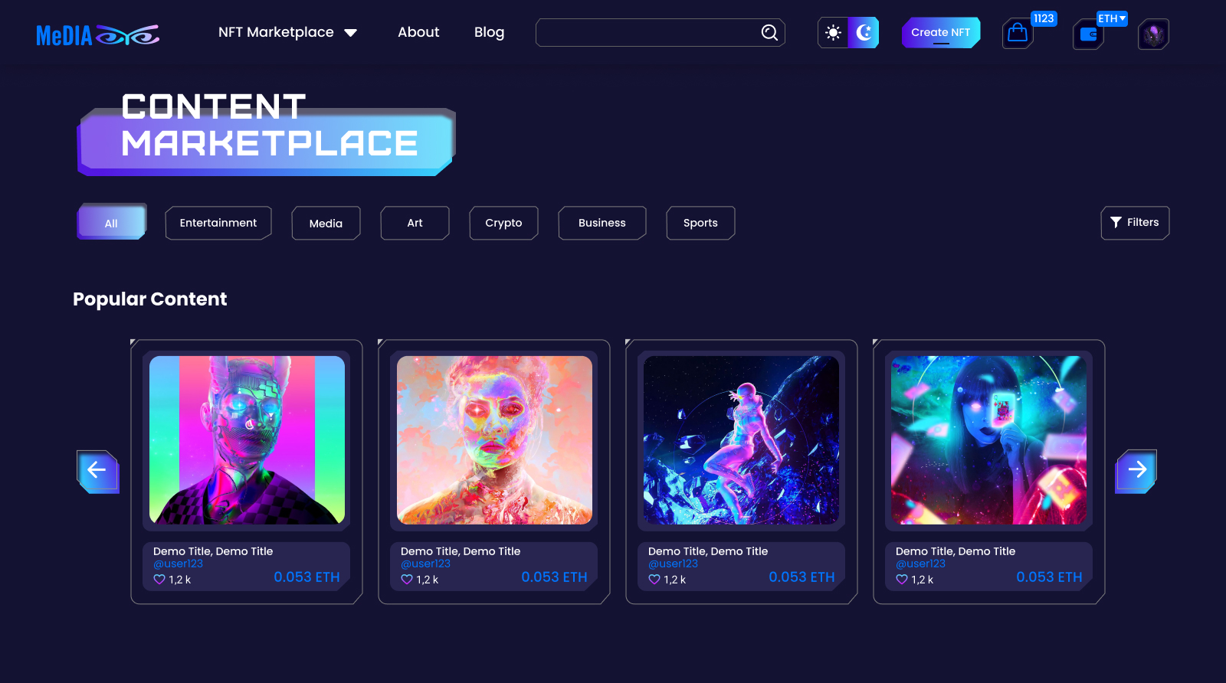

Slide 15

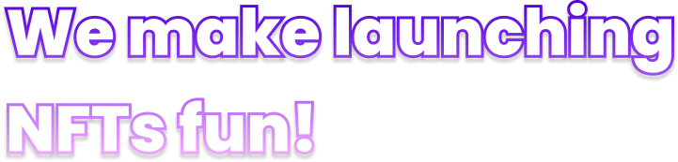
MeDIA eYe makes it easy for anybody to create NFTs or launch dedicated promotion campaigns using NFTs. It is a platform that services both the novice and the experienced, using advanced applications of crypto-economics to create unprecedented liquidity and price-discovery of NFTs offered in the MeDIA eYe marketplace.
MeDIA eYe is the most user-friendly and intuitive NFT launcher for any business to enter the digital creator economy. NFTs on MeDIA eYe are free to mint, and the costs for launching NFT Campaigns are affordable for every level of digital content creator or advertiser.

Slide 16
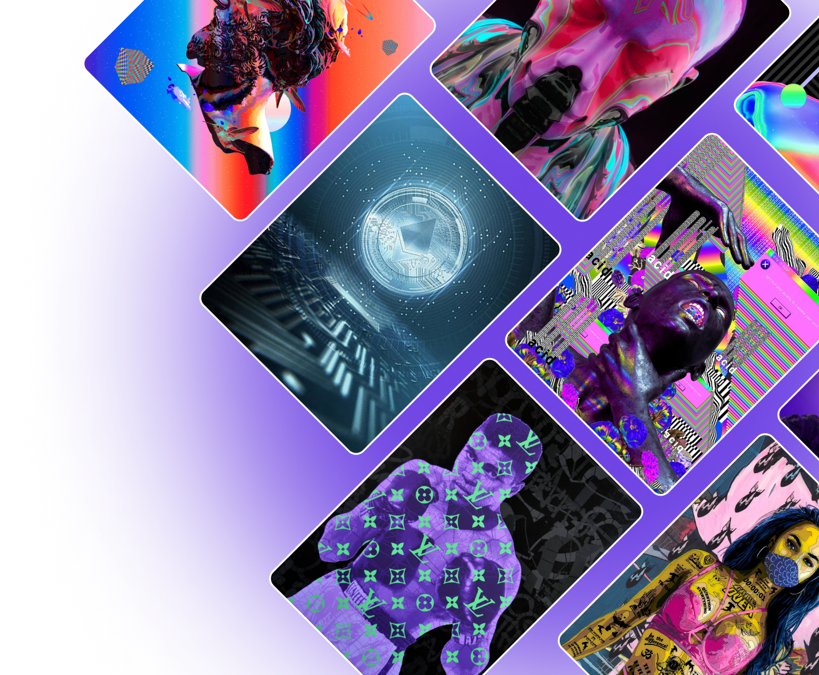
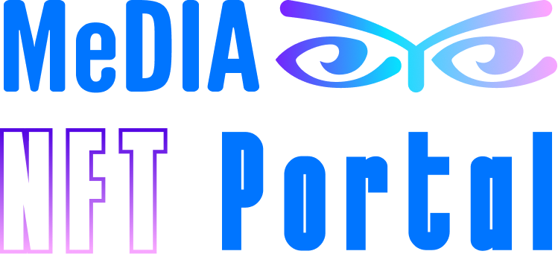

Slide 17
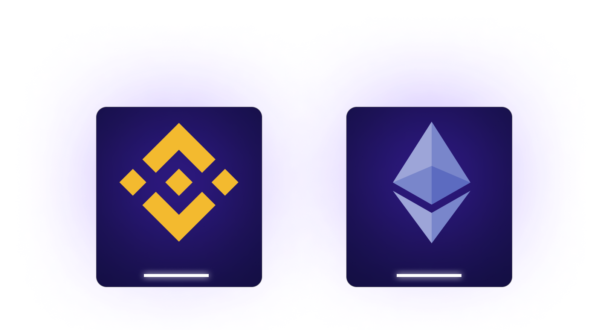


Slide 18

The MeDIA eYe NFT Portal Concept is developed
Presale and IDO Fundraising Platform Launch (Beta)
Development MeDIA eYe Platform and Testing
MeDIA eYe Staking Pool and Rewards Pool Launch, platform goes into full operation

Slide 19

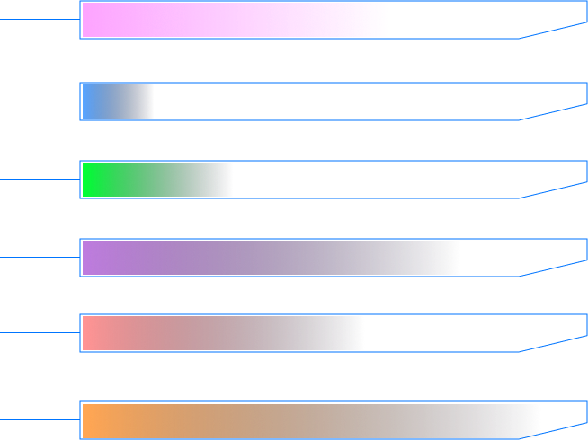
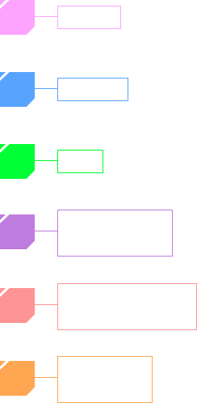
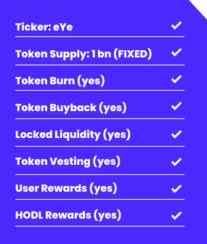
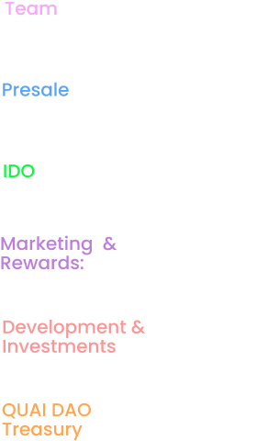

Total token supply:
1 Billion (fixed supply)
500M ERC20 and 500M BEP20
230M eYe (vesting 24 to 36 months)
25M eYe ($0.015 per eYe token)
75M eYe ($0.02 to 0.03 per eYe token) 60% locked liquidity
220M eYe
200M eYe
250M eYe

Slide 20



Low fees
Frictionless user interface
eYe token holder discounts
eYe token burn
eYe token buyback
eYe token staking
eYe token allocations for creative partners
eYe token automated rewards pools for frequent users on

Slide 21

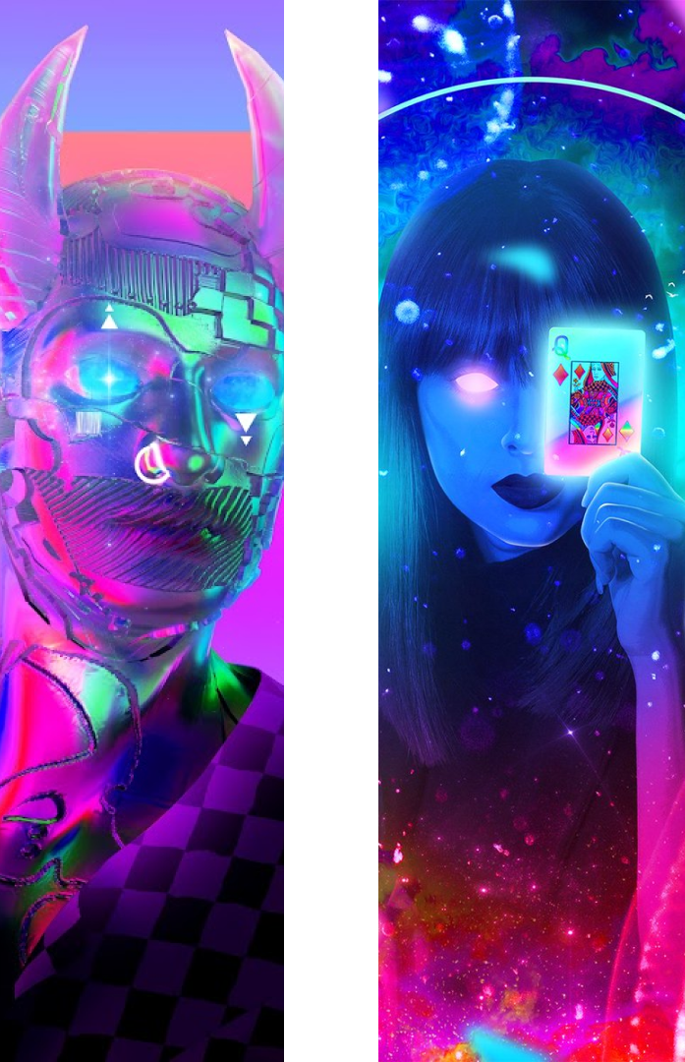
Cross chain services ETH and BSC
Cross chain minting 721 and 1155
Cross chain subscription model
Cross chain NFT transfer
Cross chain campaign launcher

Slide 22


Content Marketplace
NFT Marketplace
Popular Content
Featured Content
NFT Gallery
Upload content free up to 200MB
Distributed + blockchain storage for content files and metadata
Community centric
Sign up with Google, Facebook or DeFi wallet
FIAT on-ramp
Open to everyone
Non-custodial

Slide 23


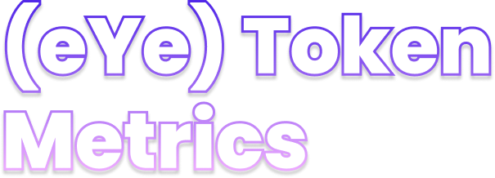
Transaction Tax Rate: A tax rate of 2% will apply to all liquidity pool transactions on Ethereum Mainnet and Binance Smart Chain.
50% of all fees are distributed to stakers and rewards fees from the NFT platform.
The eYe token is designed as a cross-chain cryptographic unit compatible with Binance Smart Chain and Ethereum blockchain networks that powers the MeDIA eYe platform. The eYe token serves as the utility vehicle on MeDIA eYe platform, powering the marketplace, campaign launcher, subscription fees, staking, and rewards.
25% of all NFT platform fees will go to operating expenses and buyback of tokens.
25% all fees generated by the NFT platform are paid to QUAI DAO for Governance and Management.

Slide 24


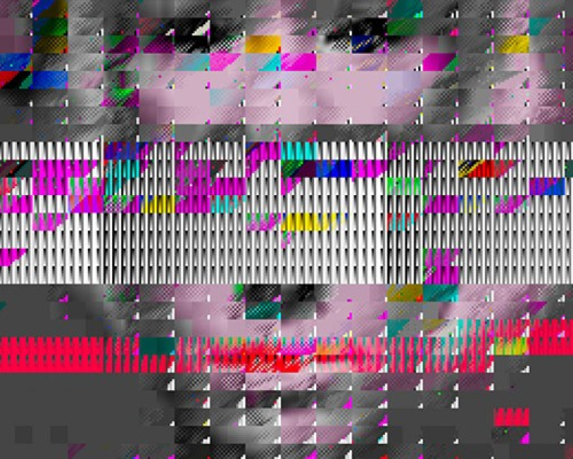
Please reach out if you have any questions or feedback.
Email Address
mediaeye@mediaeyenft.com
Twitter
Twitter.com/MeDIAeYeNFT
More details
docs.mediaeyenft.com

